Slide 1

Getting Started
Roger C. Dugan
Sr. Technical Executive, EPRI
Jacobs Hall, UCSD
Dec 14-15, 2010

Slide 2
SourceForge.Net Links for OpenDSS
OpenDSS Download Files:
  http://sourceforge.net/projects/electricdss/files/
Main Page in Wiki
  http://sourceforge.net/apps/mediawiki/electricdss/index.php?title=Main_Page
Top level of Main Repository
  http://electricdss.svn.sourceforge.net/viewvc/electricdss/
Source Code
  http://electricdss.svn.sourceforge.net/viewvc/electricdss/Source/
Examples
  http://electricdss.svn.sourceforge.net/viewvc/electricdss/Distrib/Examples/
IEEE Test Cases
  http://electricdss.svn.sourceforge.net/viewvc/electricdss/IEEETestCases/

Slide 3
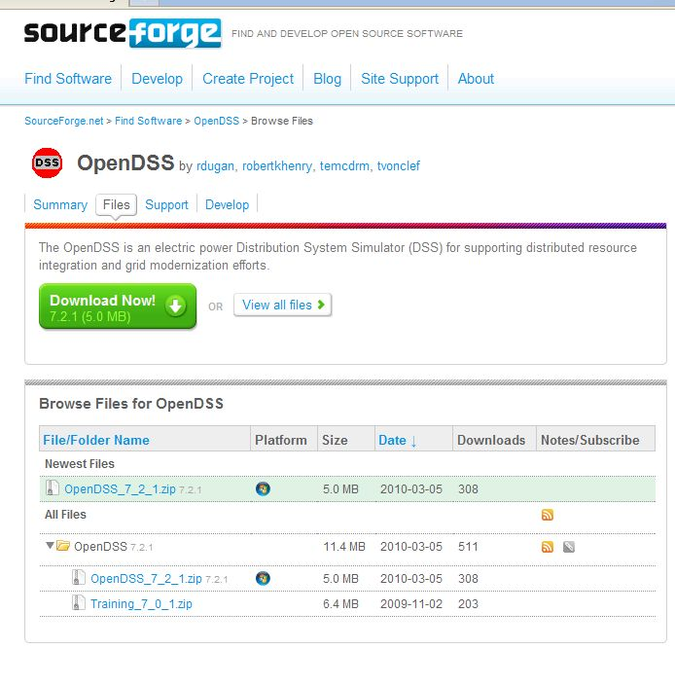
Release File Download Page
This is a Release Version

Slide 4
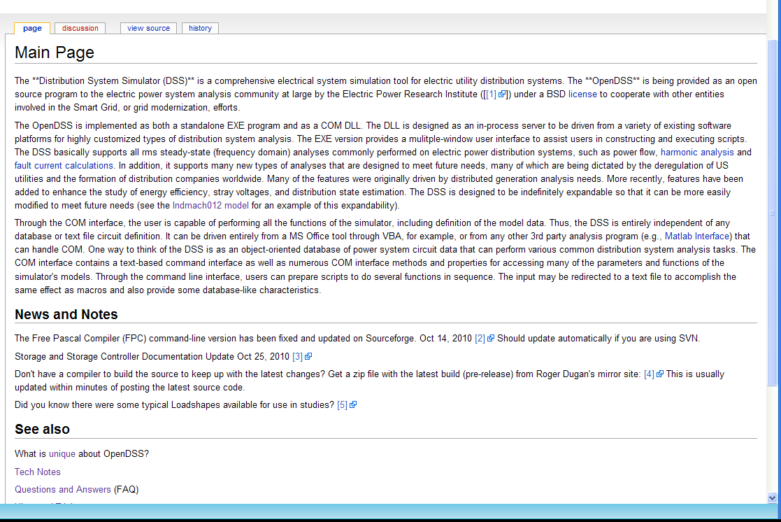
Wiki Home Page

Slide 5
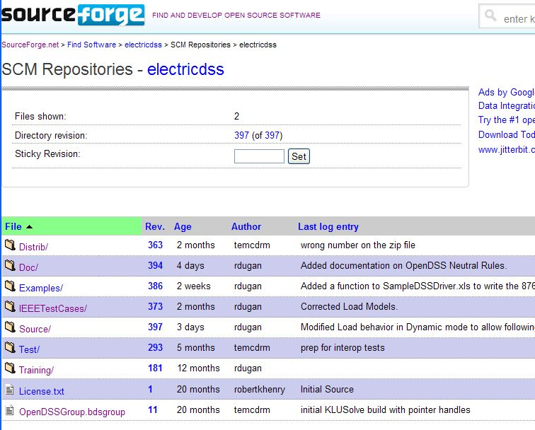
Repository on SourceForge.Net

Slide 6
Release Versions Vs. Source Code
Release versions are posted irregularly on SourceForge
You can keep up with the latest changes by accessing the source code and building the latest version
Latest builds are also posted on an EPRI FTP site
  Request a link from EPRI (see Wiki News and Notes)
  Roger Dugan’s mirror: www.rogerdugan.com
Compilers
  Delphi 2010 - This is what we use for development
    Delphi 2007 and 2009 also worked last time we tried
  Free Pascal (with limitations) -www.freepascal.org

Slide 7
Accessing the SourceForge.Net Source Code Repository with TortoiseSVN
Install a 32-bit TortoiseSVN client from tortoisesvn.net/downloads.
Recommendation:
  From the TortoiseSVN General Settings dialog and click the last check box, to use "_svn" instead of ".svn" for local working directory name.
  Then, to grab the files from SourceForge:
  1 - create a clean directory such as "c:\opendss"
  2 - right-click on it and choose "SVN Checkout..." from the menu
  3 - the repository URL is
    http://electricdss.svn.sourceforge.net/svnroot/electricdss
  Change the checkout directory if it points somewhere other than what you want.

Slide 8
Program Files
OpenDSS.EXE Standalone EXE
OpenDSSEngine.DLL In-process COM server
KLUSolve.DLL Sparse matrix solver
DSSgraph.DLL DSS graphics output
Copy these files to the directory (folder) of your choice
  Typically c:\OpenDSS or c:\Program Files\OpenDSS
If you intend to drive OpenDSS from another program, you will need to register the COM server
    Some programs require this !!

Slide 9
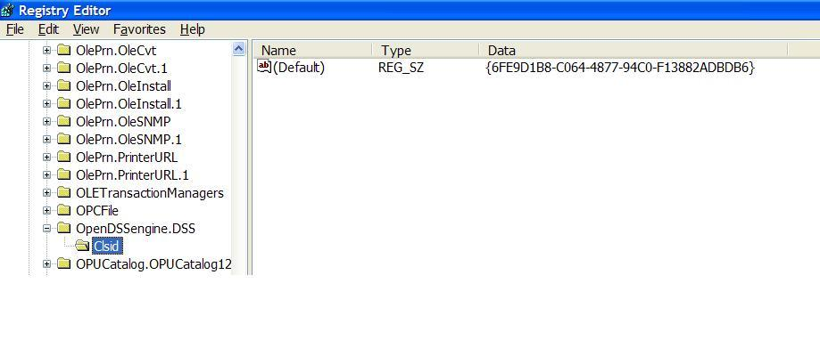
Registering the COM Server
In DOS window, change to the folder where you installed it and type:
  Regsvr32 OpenDSSEngine.DLL
GUID
The Server shows up as “OpenDSSEngine.DSS” in the Windows Registry

Slide 10
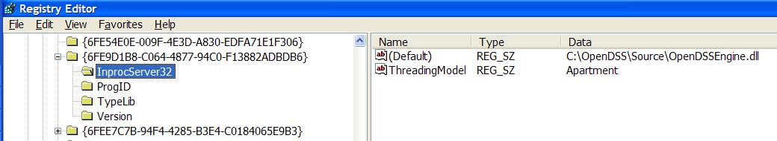
Registering the COM Server, cont’d
If you look up the GUID
Points to OpenDSSEngine.DLL
(In-process server, Apartment Threading model)

Slide 11
Accessing the COM Server
In MATLAB:
  DSSobj = actxserver(‘OpenDSSEngine.DSS’);
In VBA:
  Public DSSobj As OpenDSSEngine.DSS
  Set DSSobj = New OpenDSSEngine.DSS
In PYTHON:
  self.engine = win32com.client.Dispatch("OpenDSSEngine.DSS")

Slide 12
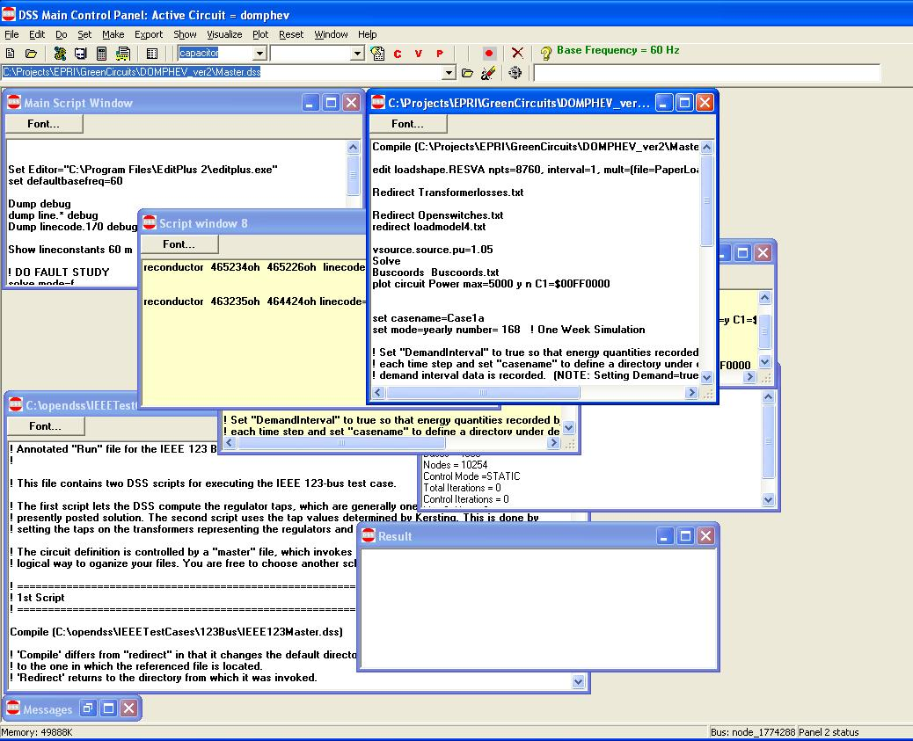
OpenDSS Standalone EXE User Interface
Multiple script windows
Any script window may be used at any time.

Slide 13
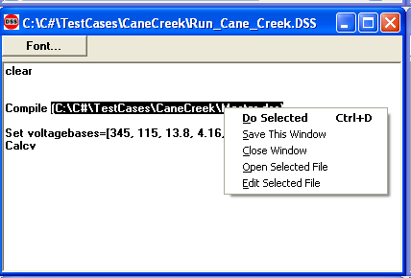
Executing Scripts in the Stand-alone EXE
Select all or part of a line
Right-Click to get this pop-up menu
DSS executes selected line or opens selected file name
Any script window may be used at any time.

Slide 14
Together…Shaping the Future of Electricity

